Slide 1
MCA Final Year Project (Review III)
E-SAHAKARA (Initialization and configuration, General Ledger & Financial Statements)
Submitted to the Presidency University, Bengaluru in partial fulfillment for the award of the degree of Master of Computer Applications(MCA)
Project Number : MCA_PR218
Ass
Under the supervision of
Mr. S. Sakthi
Asst. Prof of SCSE
Presidency University, Bengaluru
Name | Roll Number
Shubhan G C | 20232MCA0194

Slide 2
Content
Abstract
Problem Statement
Literature Survey
Tools and Technologies
Screenshots
References
GitHub link

Slide 3
Abstract
Automating Setup – Digital system setup and access control help improve security and reduce errors.
Managing Finances Easily – Automated financial tracking and reporting make accounting more accurate and efficient.
Problems in Current Systems – Many cooperative financial systems lack real-time tracking and customization, causing delays.
Need for a Better Solution – A combined system can improve security, transparency, and efficiency in financial management.
Future Improvements – Using AI and cloud-based solutions can further enhance cooperative financial systems.

Slide 4
Problem Statement
Lack of Standardized Setup - Cooperative societies struggle with inconsistent system configurations, leading to operational inefficiencies and compliance issues.
Data Validation Issues – The absence of automated validation mechanisms results in inaccurate member and financial records, impacting decision-making
Inaccurate Financial Tracking – Manual bookkeeping leads to errors in transaction records, affecting financial integrity and decision-making.
Audit and Reporting Challenges – The absence of structured audit trails makes financial verification and reporting cumbersome, increasing the risk of discrepancies.

Slide 5
Literature Survey
Sl No. | Title of Paper | Year | Methodology Used | Challenges Faced | Advantages | Disadvantages
1 | System Initialization and Role-Based Access Control in Financial Platforms | 2023 | Automated system setup, role-based access control (RBAC) implementation | Security vulnerabilities in manual configuration, lack of user access restrictions | Enhances security, reduces manual errors, ensures compliance | Implementation complexity for non-technical users
2 | Automated Financial Management and General Ledger Systems in Cooperative Societies | 2022 | Financial tracking, reconciliation, and compliance-integrated reporting | Difficulty in integrating automation with legacy systems | Improves accuracy, efficiency, and decision-making | High initial cost of implementation
3 | Gaps in Financial Customization for Cooperatives: A Study on Existing Solutions | 2024 | Comparative analysis of existing financial software and customization needs | Lack of tailored solutions for cooperative accounting | Highlights the need for an integrated and customizable financial system | Limited real-world case studies on cooperative-specific financial models

Slide 6
Tools And Technologies
Development Tools: Visual Studio, Android Studio
Programming Languages: HTML,CSS, PHP, JAVASCRIPT
Frameworks/Libraries: React, Bootstrap
Database: MySQL, MongoDB
Additional Tools: APIs, Cloud Services

Slide 7

Screenshots
Login Page

Slide 8
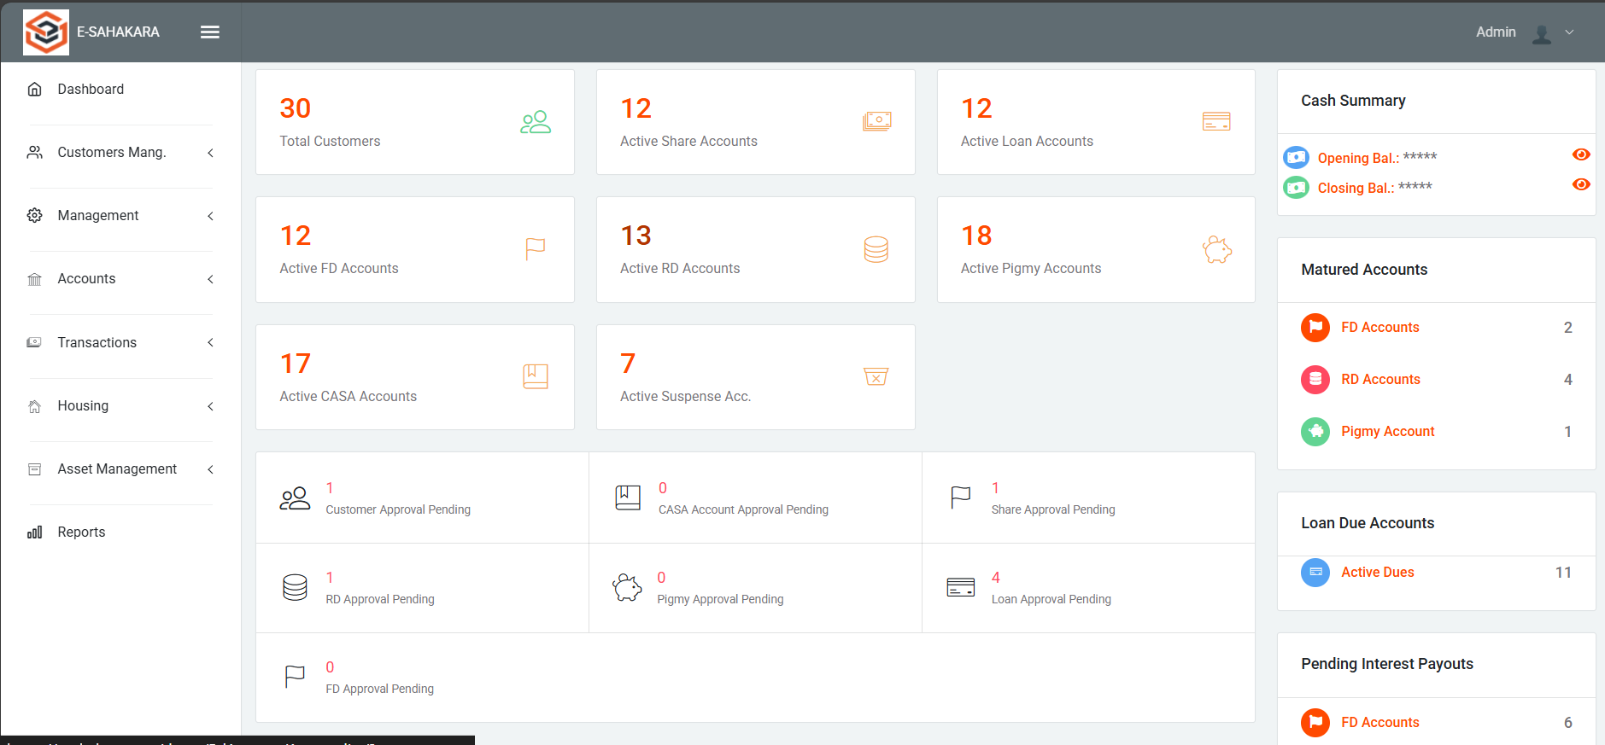
Dashboard

Slide 9
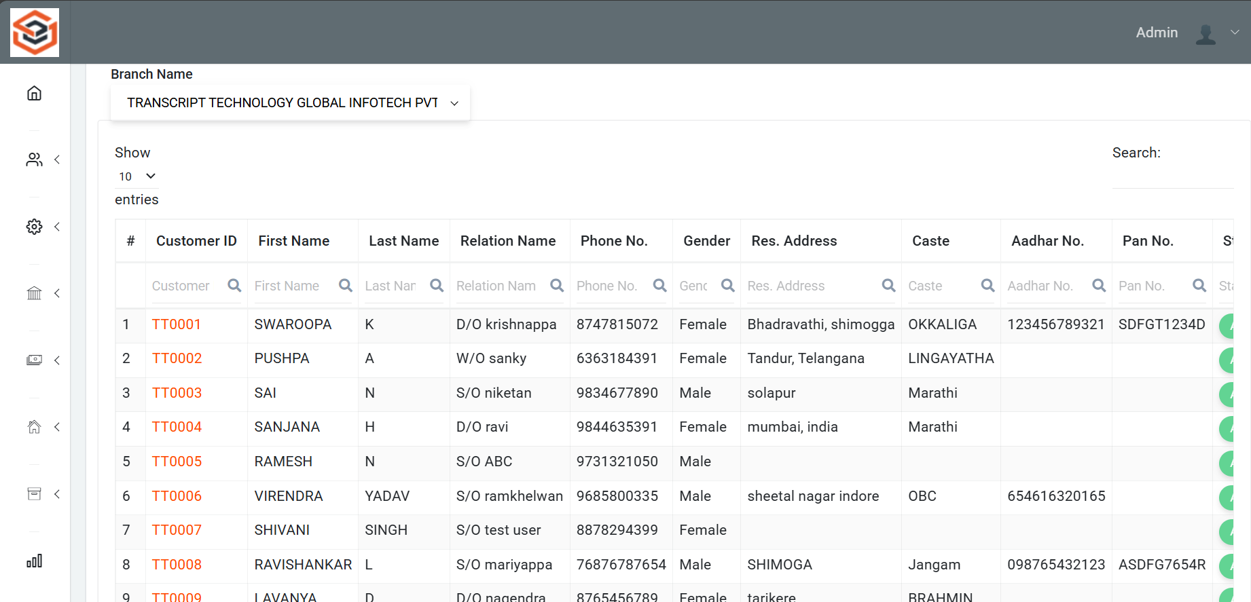
Customer list

Slide 10
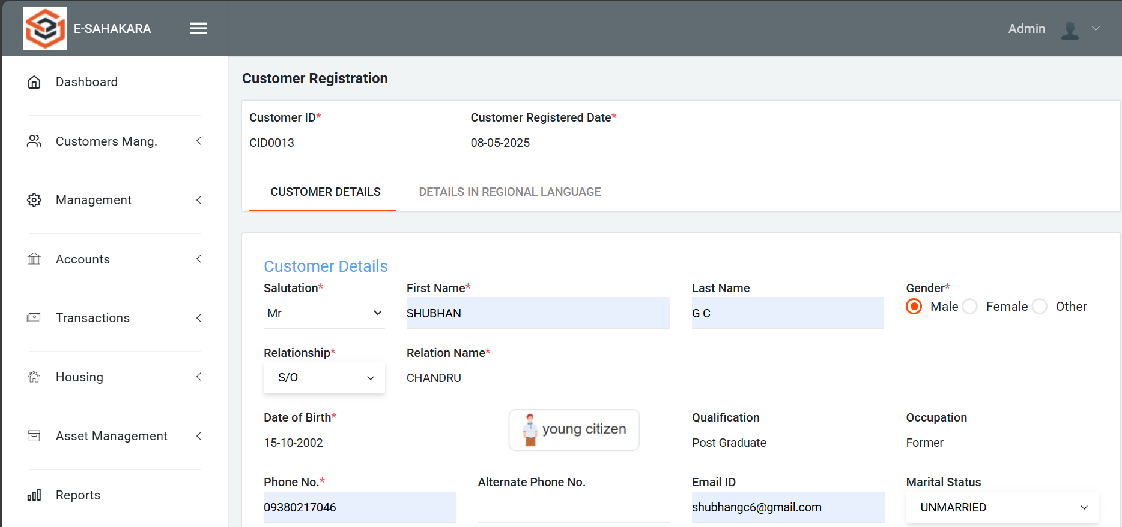
Customer Registration Form

Slide 11
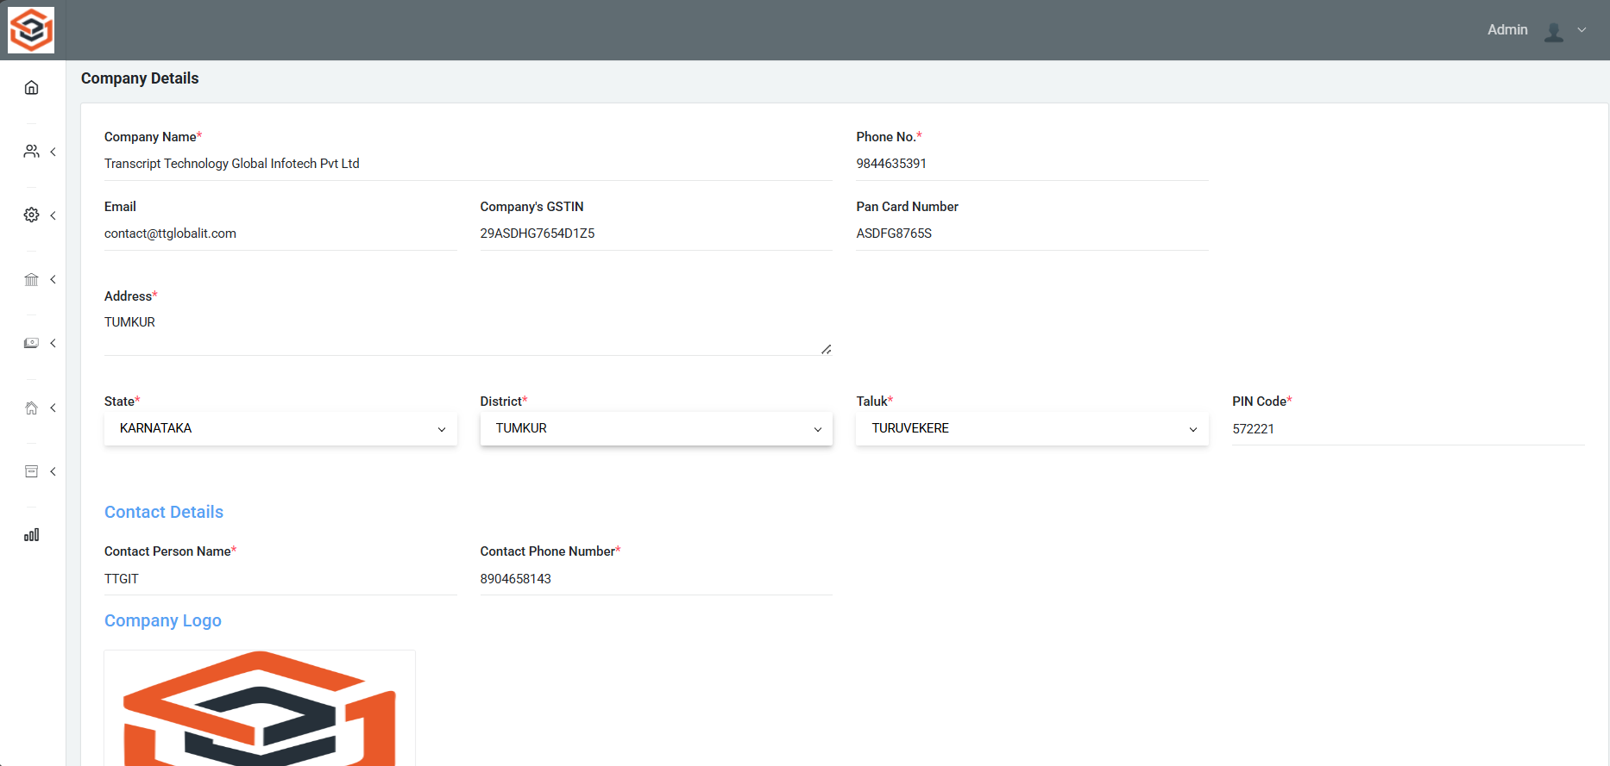
Company Details

Slide 12
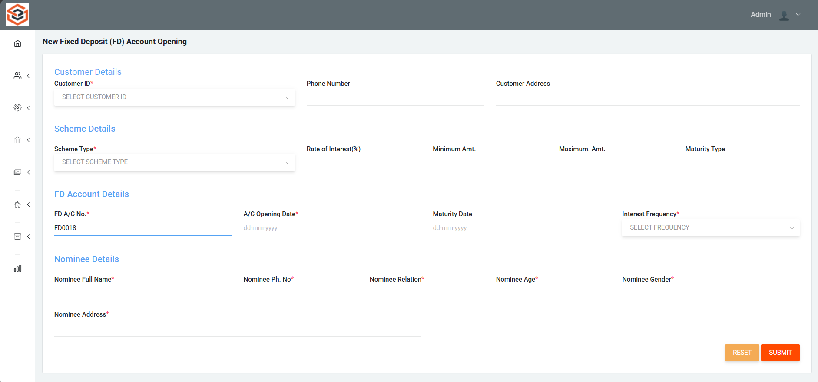
FD Account opening page

Slide 13
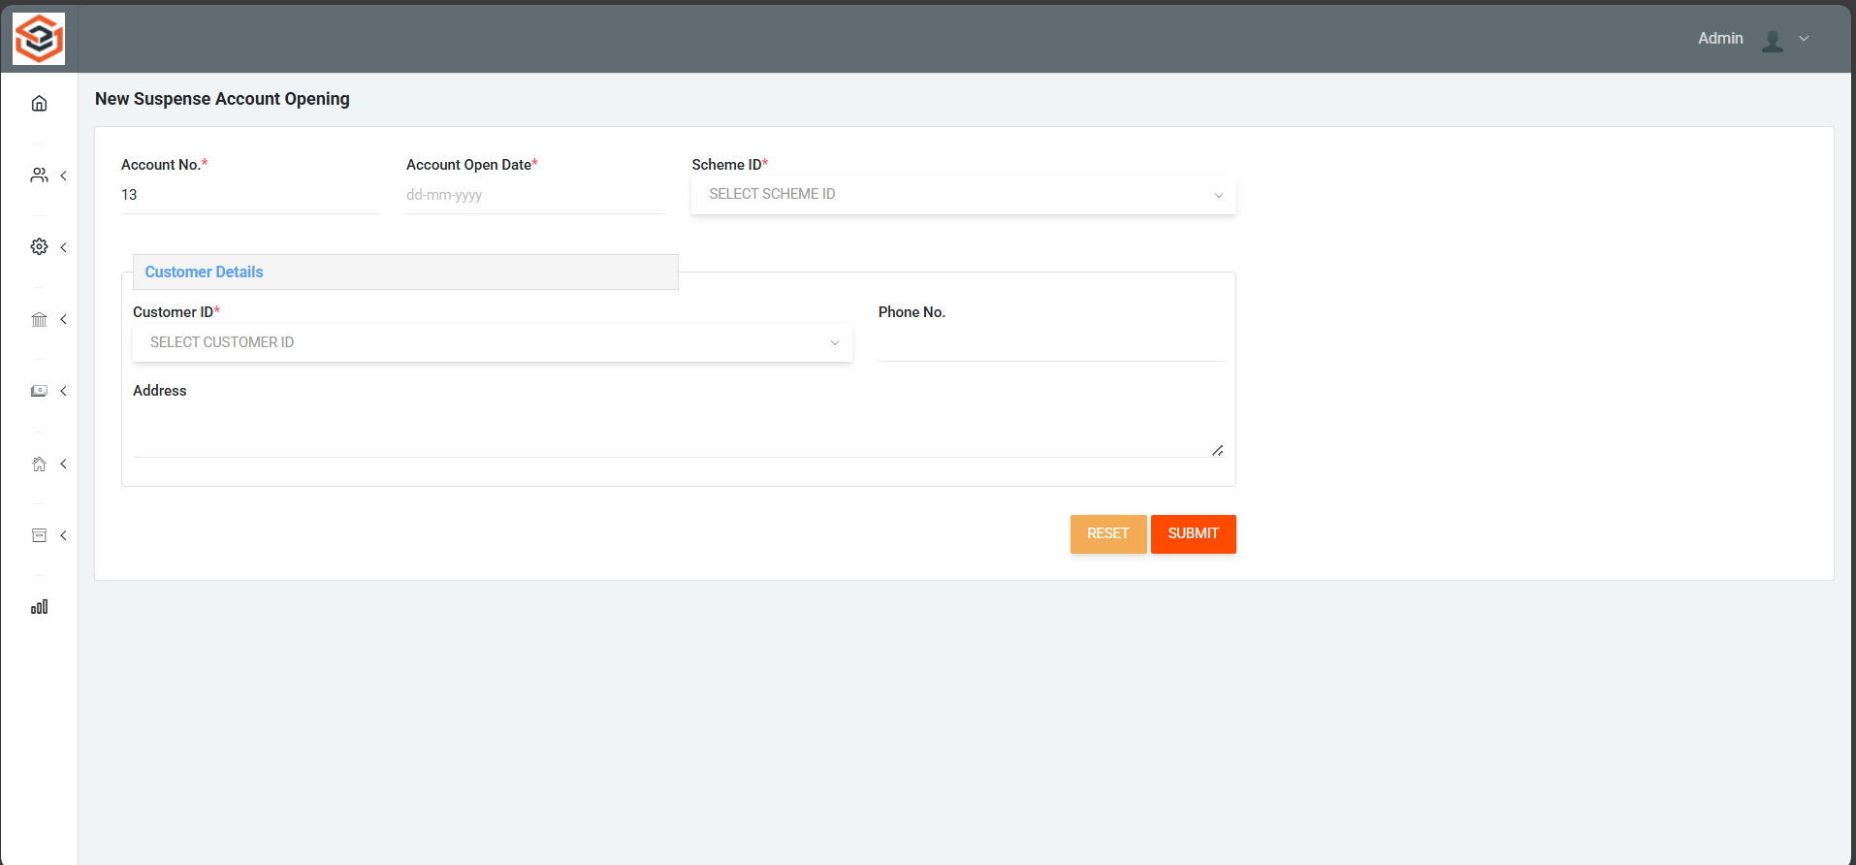
Suspense Account opening page

Slide 14
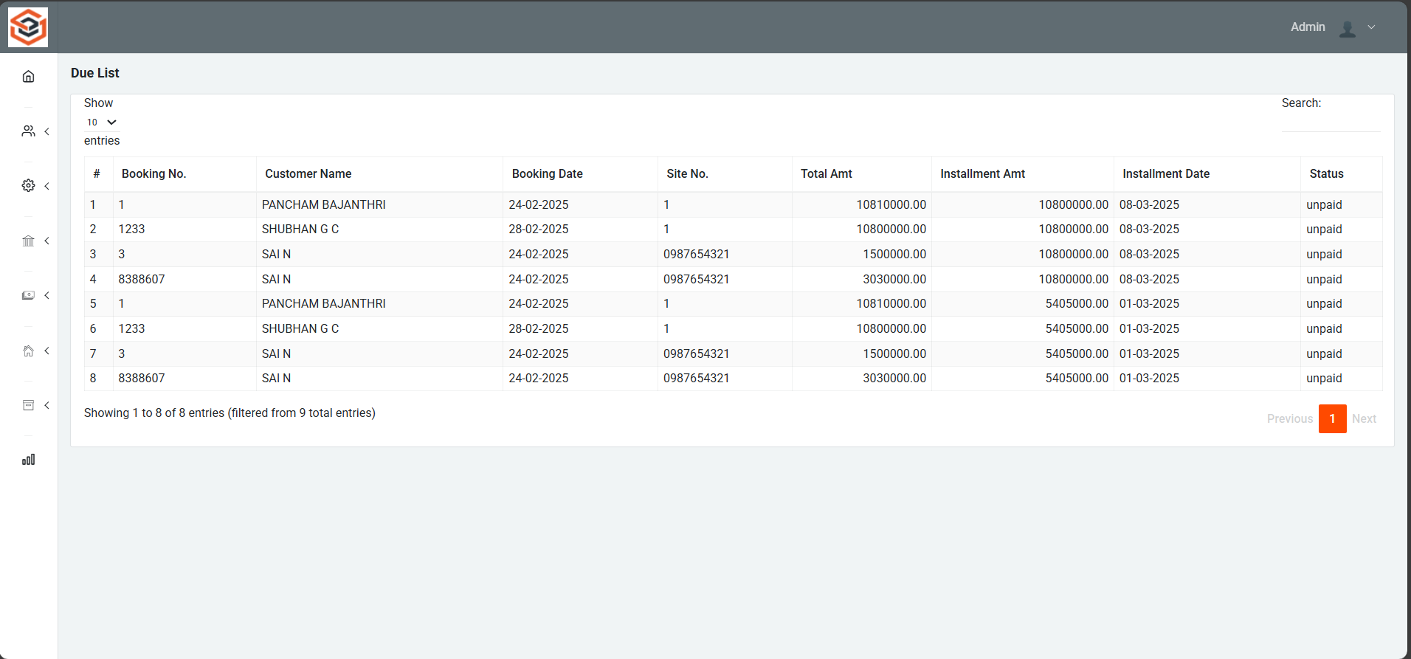
Loan Due List page

Slide 15
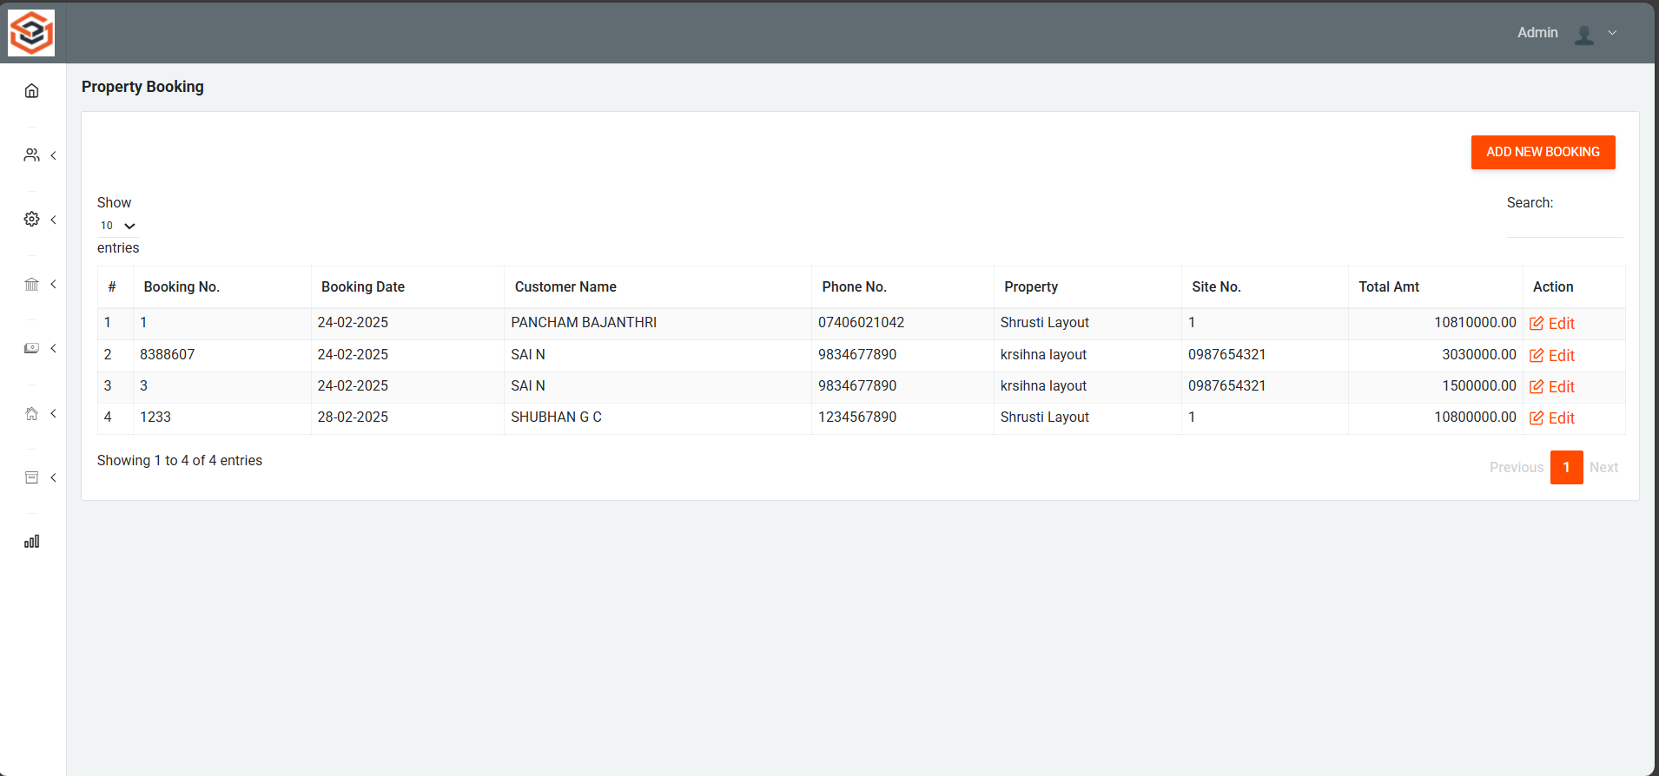
Property Booking Page

Slide 16
Loan Due List page

Slide 17
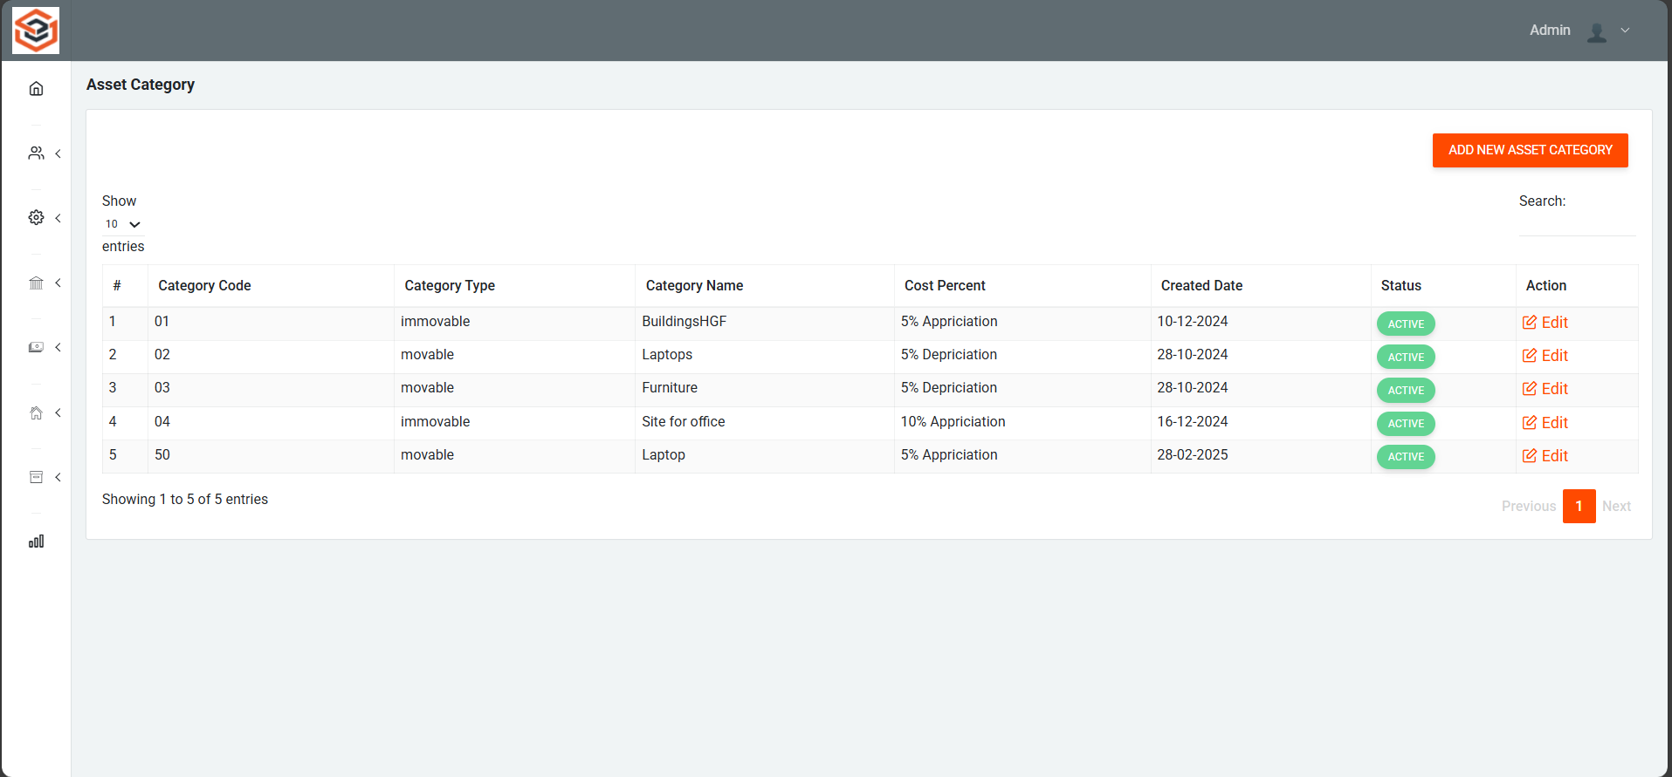
Asset Category List

Slide 18
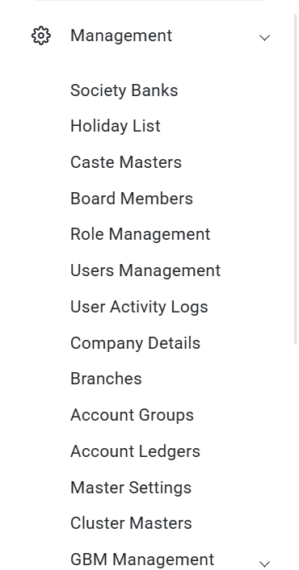
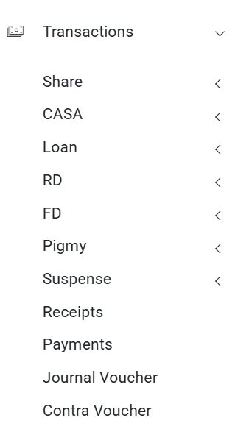
Management & Transactions

Slide 19
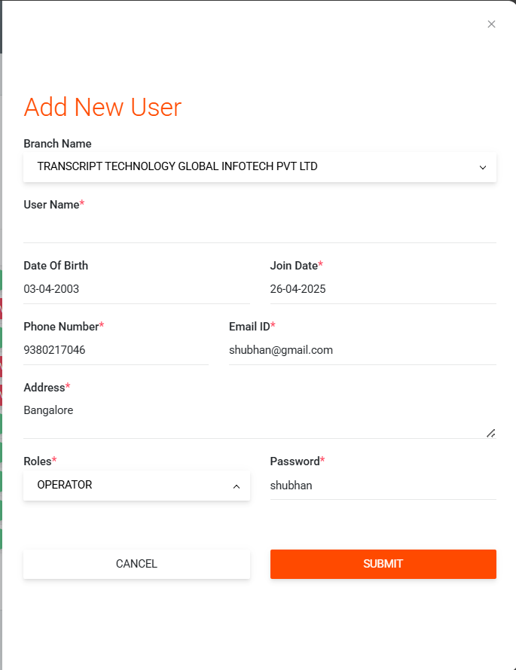
Add New User

Slide 20
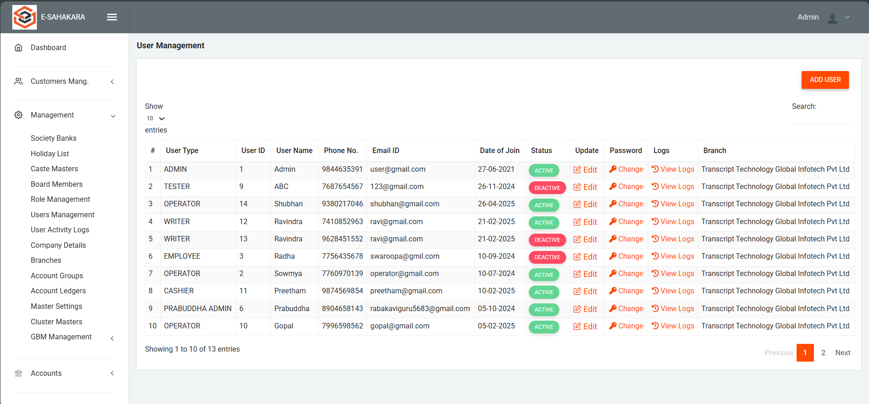
User Management

Slide 21
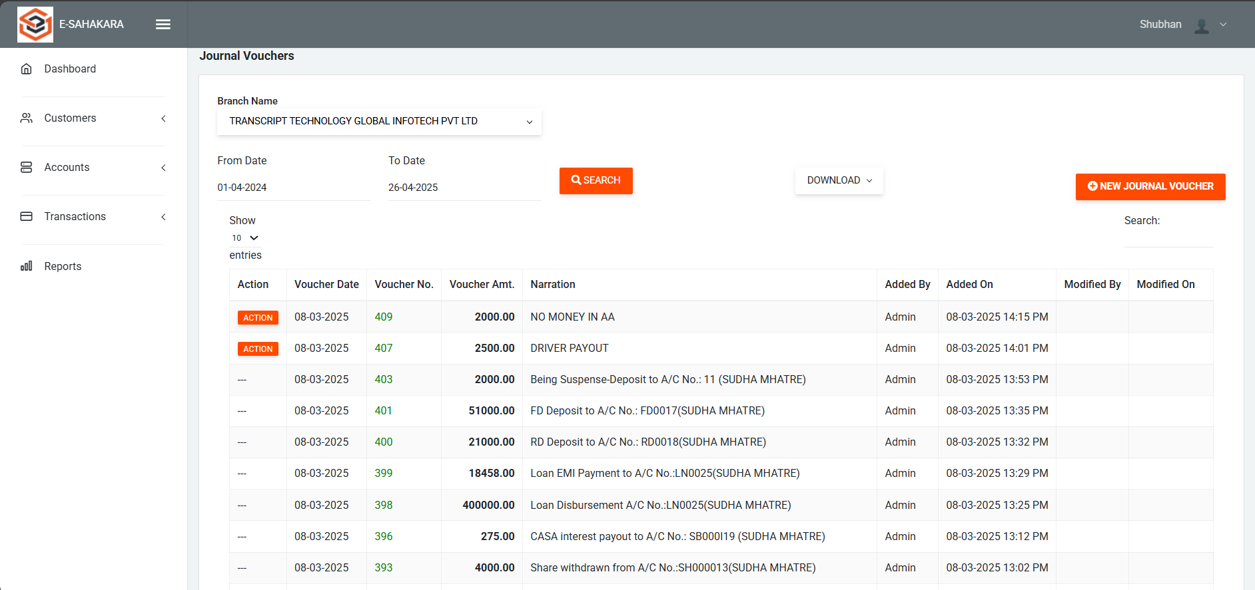
Journal Vouchers

Slide 22
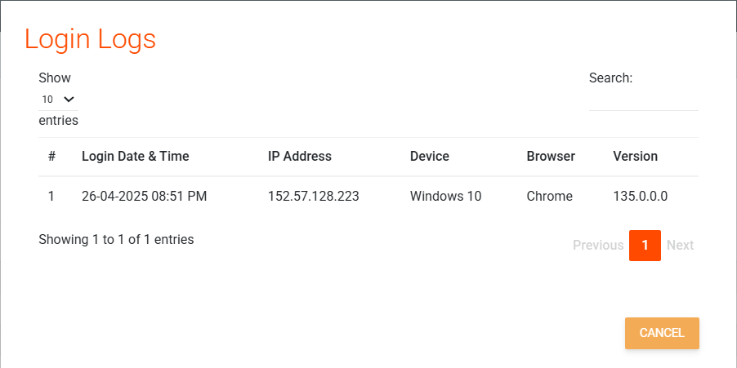
Login logs of user

Slide 23
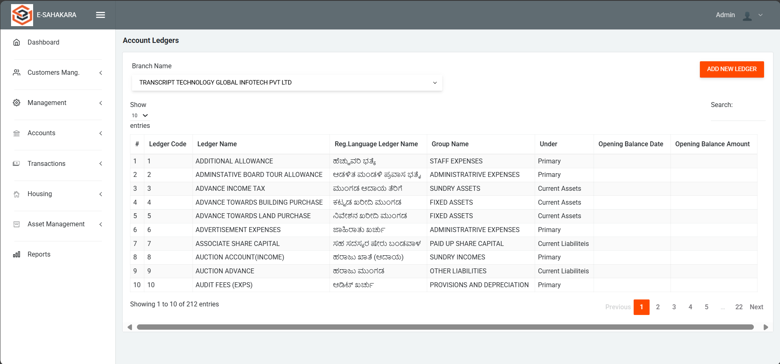
Account Ledgers

Slide 24
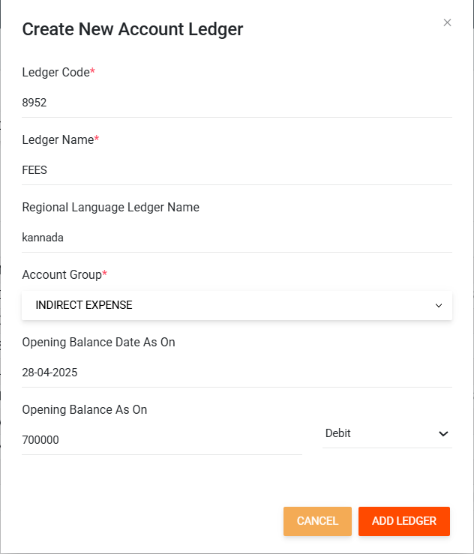
Create New Ledger

Slide 25
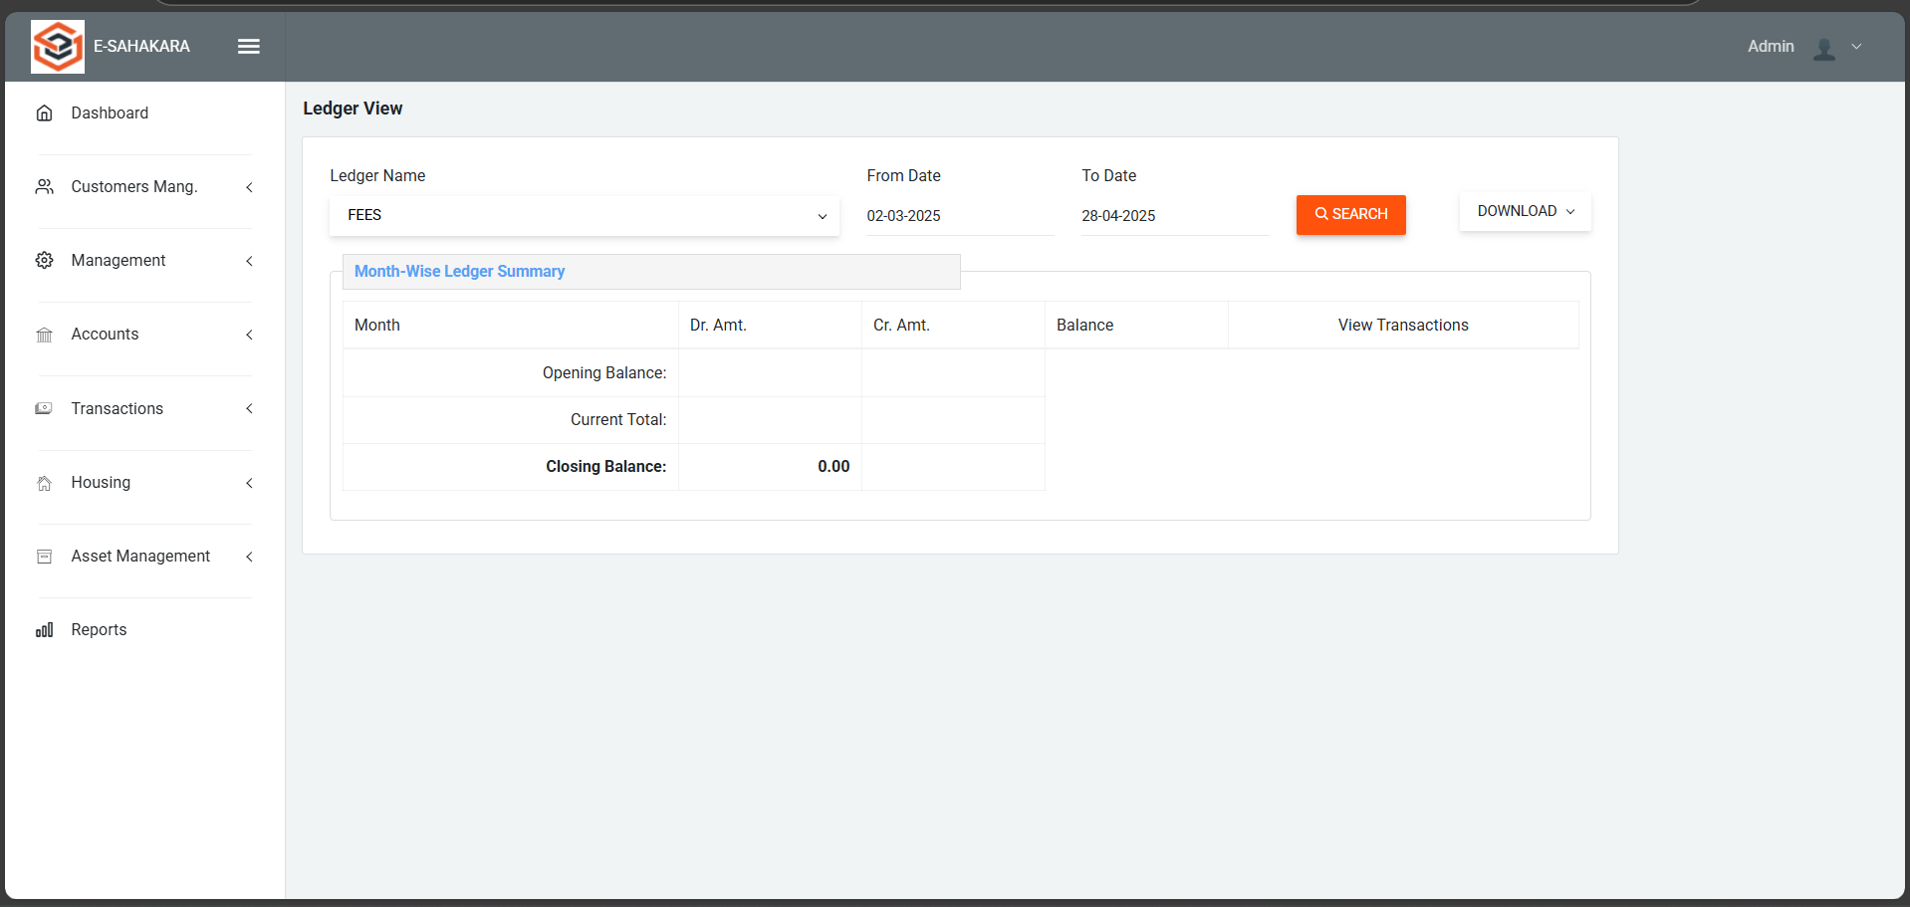
Ledger View

Slide 26
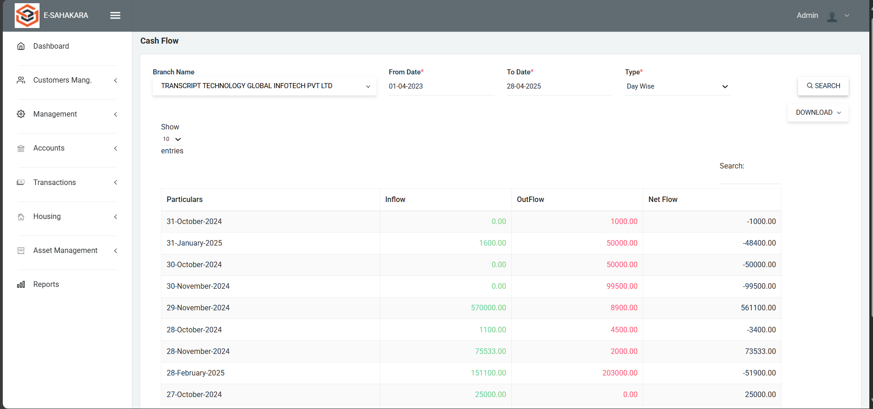
Cash Flow (Day wise)

Slide 27
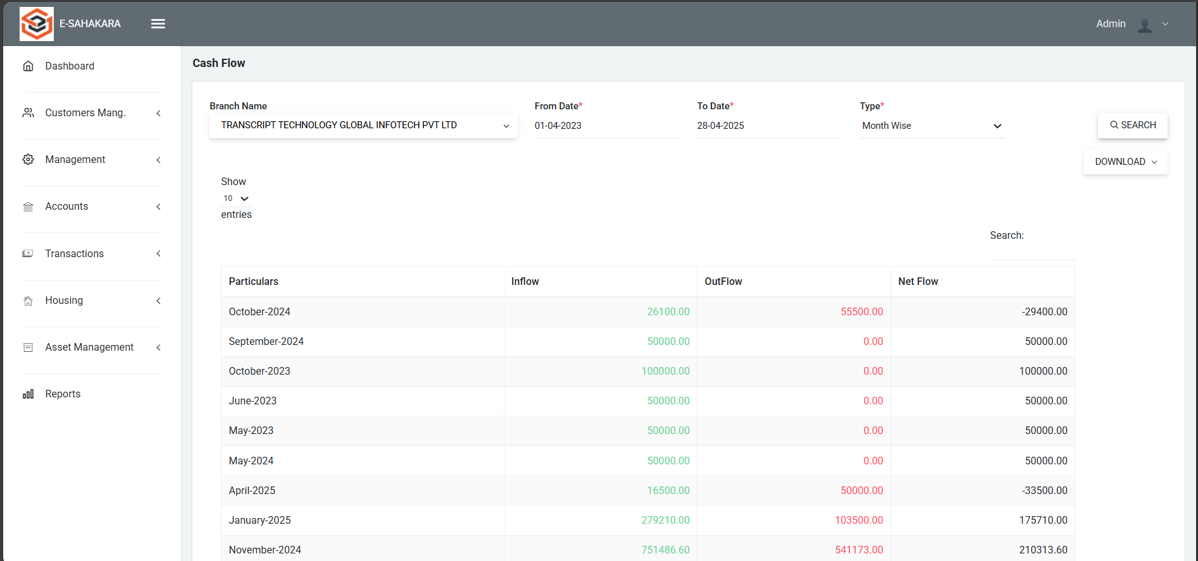
Cash Flow (Month wise)

Slide 28
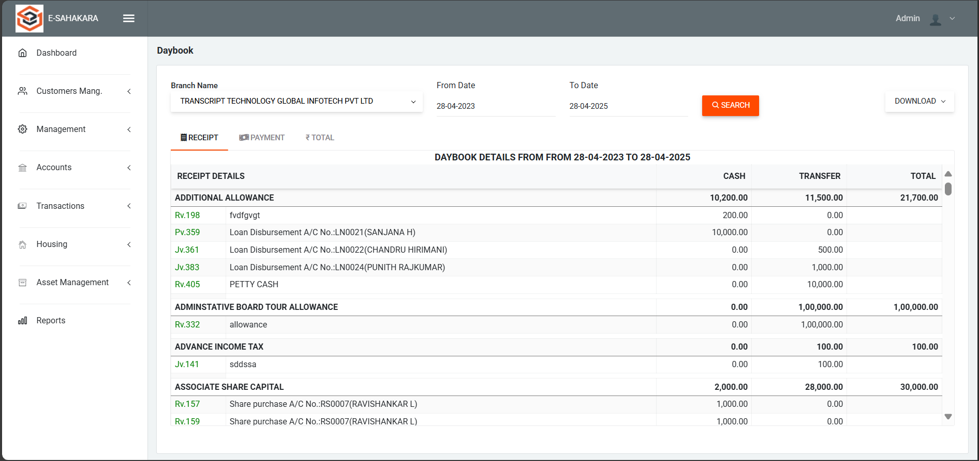
Daybook (Receipt)

Slide 29
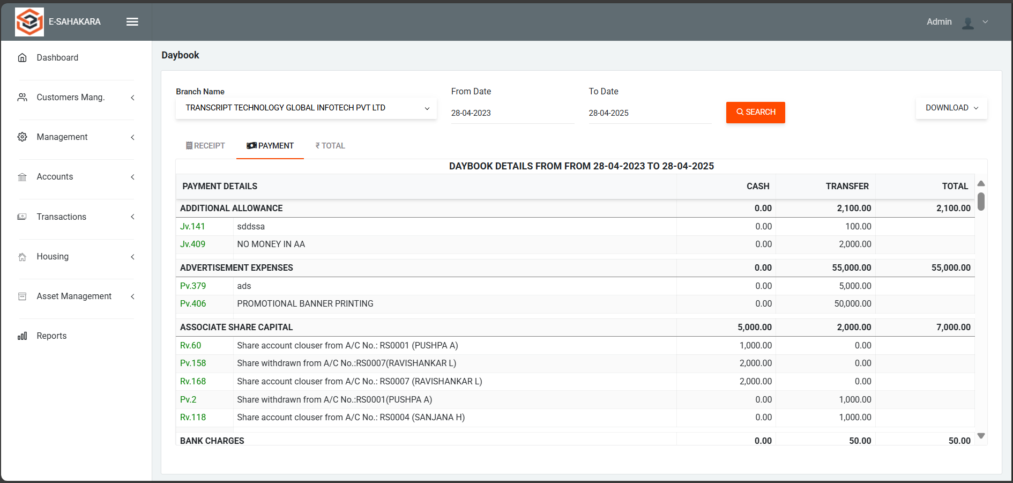
Daybook (Payment)

Slide 30
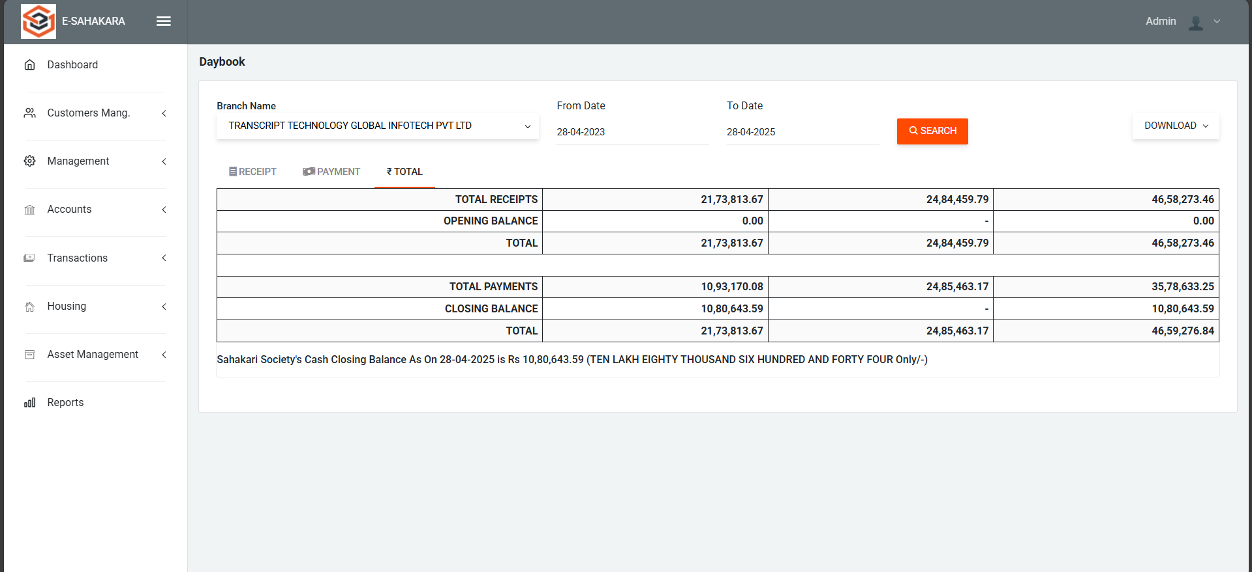
Daybook (Total)

Slide 31
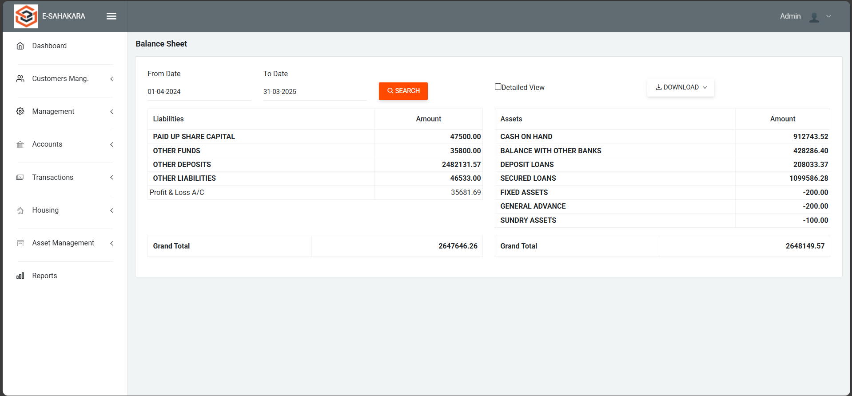
Balance Sheet

Slide 32
References
Digitalisation and Digital Transformation in the Social Economy: The Cases of Anecoop and Consum https://www.emerald.com/insight/content/doi/10.1108/BFJ-12-2022-1086/full/html
Digital Transformation in Indian Co-operative Banks https://www.tannum.io/2024/08/26/digital-transformation-in-indian-co-operative-banks/
Digital Transformation and Financial Performance of Deposit-Taking Savings and Credit Co-Operatives in Nairobi City County, Kenya https://edinburgjournals.org/journals/index.php/journal-of-finance-and-accountin/article/view/172

Slide 33
GitHub Link
GitHub Repository:
https://github.com/Shubhangc6/E-Sahakara

Slide 34


